Slide 1
Blockchain & Business Application
Lecture:
Cryptography & Cryptocurrencies

Slide 2

Book’s Chapter 1: Introduction to Cryptography & Cryptocurrencies

Slide 3
Currencies require
Ways to control supply
Security to prevent cheating
Central banks do both
Security makes it more difficult for attacker not possible
Law enforcement needed!
Cryptocurrencies (CC)
Pure technological methods → Crpytography
Requiring no authority

Slide 4
Two basic primitives to construct CC
Cryptographic hash function
Hash function?
Hash pointers
Digital Signatures

Slide 5
Hash Function Properties
Input: Any string of any size.
Output: Fixed size.
This lecture: 256-bit
Efficiently computable:
Reasonable amount of time
n-bit string: Running time O(n).

Slide 6
Cryptographic Hash Function Properties
Three additional properties:
1) Collision‐resistance
2) Hiding
3) Puzzle‐friendliness
This is not general but required for CCs.

Slide 7
Cryptographic Hash Function Properties 1
Three additional properties:
1) Collision‐resistance
2) Hiding
3) Puzzle‐friendliness

Slide 8
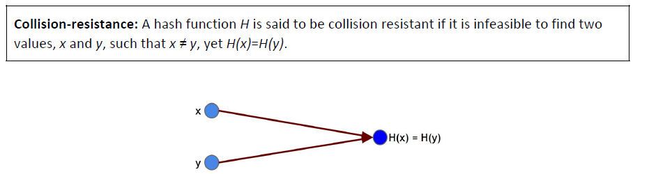
Collision‐resistance
The claim:
Nobody can “find”
Not “it does not exist”

Slide 9
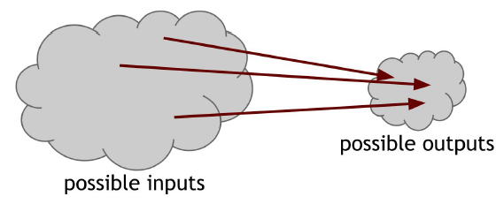
Collision‐resistance
For a hash function with a 256‐bit output size:
pick 2²⁵⁶ + 1 distinct values
Compute their hashes
Check if any pair is equal. Result? Pigeonhole Principle

Slide 10
Collision‐resistance
For a hash function with a 256‐bit output size:
Pick 2²⁵⁶ + 1 distinct values:
Will find collision 100%
What about smaller number of values?
Pick 2¹³⁰ + 1 distinct values:
Will find collision 99.% !!!
Birthday Paradox

Slide 11
Collision‐resistance
100%, but can we really find collision?
Calculate 2²⁵⁶ + 1 w.c. or, on avg. 2¹²⁸ Hashes
If a computer calculates 10K Hashes / sec
Needs 2²⁷ years
Finding one in reasonable some time.. Infinitesimally smally small probability!

Slide 12
Collision‐resistance
Counter-example
H(x) = x mod (2²⁵⁶)
x₁ = 3
x₂ = 3 + 2²⁵⁶
H(x₁) = H(x₂) =3
So what? Research required for Hash func’s!

Slide 13
Collision‐resistance
Business Application:
Online file storage systems
Upload, wait, download back.
Is it the same?
Don’t keep the original file
Keep its Hash!

Slide 14
Cryptographic Hash Function Properties 2
Three additional properties:
1) Collision‐resistance
2) Hiding
3) Puzzle‐friendliness

Slide 15
Hiding
if we’re given the output of the hash function y = H(x)
there’s no feasible way to figure out what the input, x , was
Deterministic functions → Decrease prob.
Non-deterministic functions →Totally secure!

Slide 16
Hiding
Business Application:
Commitments: Digital analog of
taking a value,
sealing it in an envelope,
putting that envelope out on the table
You’ve committed yourself
Secret from everyone

Slide 17
Hiding
two algorithms:
com := commit( msg, nonce ) The commit function takes a message and secret random value, called a nonce, as input and returns a commitment.
verify( com, msg, nonce ) The verify function takes a commitment, nonce, and message as input. It returns true if com == commit( msg , nonce ) and false otherwise
Require the following two security properties hold:
Hiding : Given com , it is infeasible to find msg
Binding : It is infeasible to find two pairs
(msg, nonce) & (msg’, nonce’) such that
msg ≠ msg’ & commit( msg, nonce ) == commit( msg’, nonce’ )

Slide 18
Hiding
These algorithms actually behave like
sealing & opening an envelope
Every time you commit to a value, choose a new random value nonce.
In cryptography, the term nonce is used to refer to a value that can only be used once.

Slide 19
Cryptographic Hash Function Properties 3
Three additional properties:
1) Collision‐resistance
2) Hiding
3) Puzzle‐friendliness

Slide 20
Puzzle‐friendliness
A hash function H said to be puzzle‐friendly if:
For every possible n‐bit output value y ,
if k is chosen from a distribution with high min‐entropy,
then it is infeasible to find x such that
H(k ‖ x) = y in time significantly less than 2^{n} .

Slide 21
(min-entropy)
A measure of how predictable an outcome is
High: the distribution is very spread out.
Means:
when we sample from the distribution, there’s no particular value that’s likely to occur.
A concrete example:
if r is chosen uniformly from among 256-bit strings
then any particular string was chosen with probability 1/2²⁵⁶ : infinitesimally small value.

Slide 22
Puzzle‐friendliness
Business Application:
Search puzzles
It has no shortcut (honeybee)
No method to solve
Just search the whole space

Slide 23
SHA-256
A particular Hash function
Bitcoin uses!
Input size: fixed or arbitrary?
We require arbitrary
Merkle‐Damgard transform
Compression function .
Proven: If the underlying compression function is collision resistant, then the overall hash function is collision resistant as well.

Slide 24
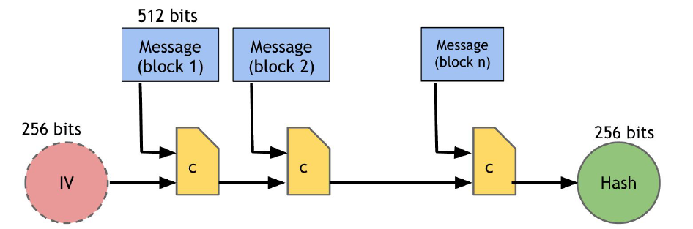
How SHA-256 works (simplified)
Notes:
MIM

Slide 25
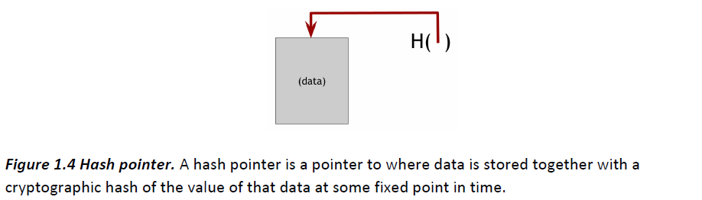
Hash Pointers & Data Structures
Regular pointer gives you a way to retrieve the information
A hash pointer also gives you a way to verify that the information hasn’t changed

Slide 26
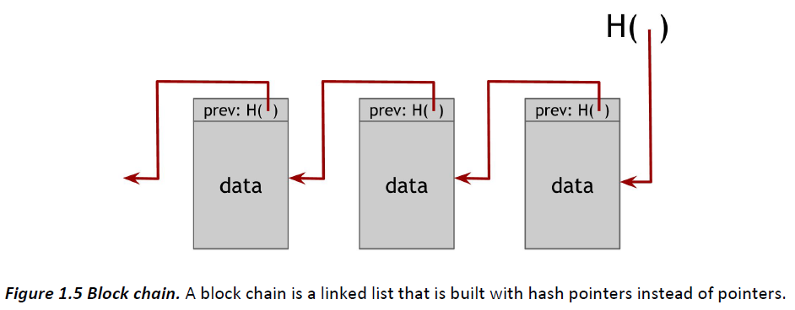
Blockchain

Slide 27
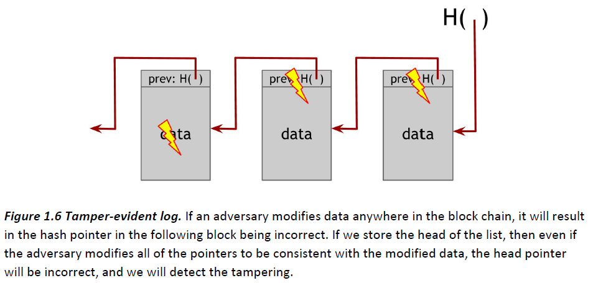
Blockchain

Slide 28
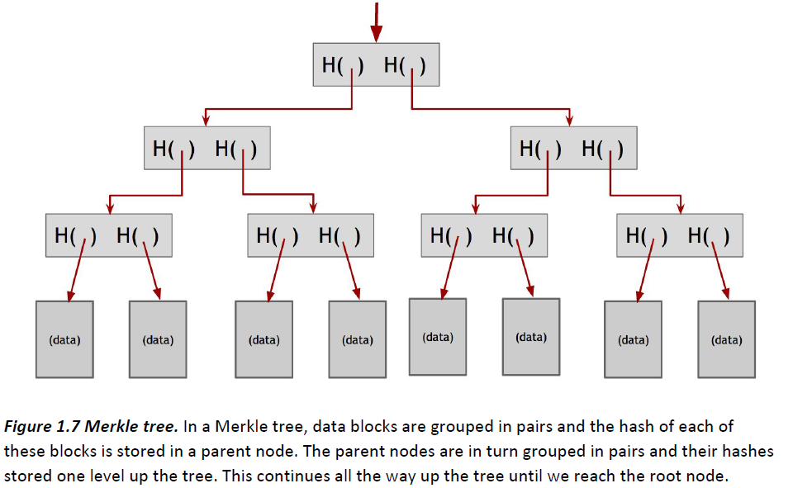
Merkle Trees
A binary tree with hash pointers

Slide 29
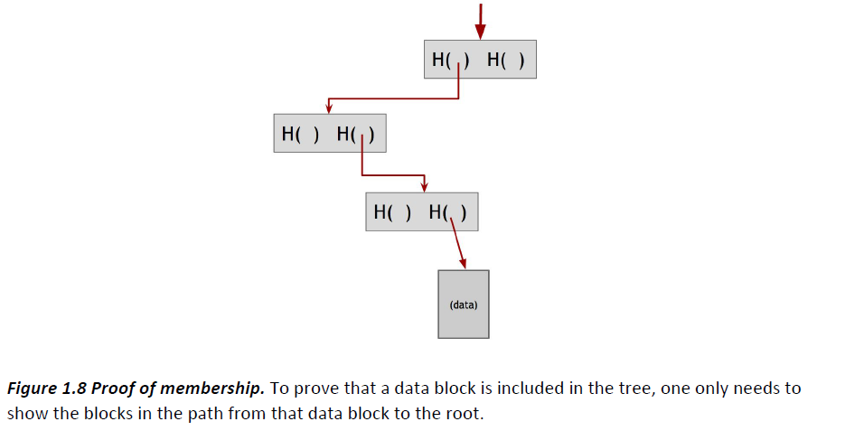
Merkle Trees & Proof of Membership
n nodes in tree: only log(n) items to show

Slide 30
Proof of Non-membership
Sorted Merkle Trees!
Verify the non-membership requires
Only logarithmic time&space!

Slide 31
Two basic primitives to construct CC
Cryptographic hash function
Hash function?
Hash pointers
Digital Signatures

Slide 32
Digital Signatures
Handwritten signature:
Only you can make your signature, but anyone who sees it can verify that it’s valid.
Signature to be tied to a particular document
Digital signatures?

Slide 33
Three algorithms:
(sk, pk) := generateKeys( keysize )
sk: secret key, used to sign messages.
pk: public verification key.
sig := sign( sk , message )
isValid := verify( pk , message , sig )
We require that following two properties hold:
Valid signatures must verify
verify( pk , message , sign ( sk , message )) == true
Signatures are existentially unforgeable

Slide 34
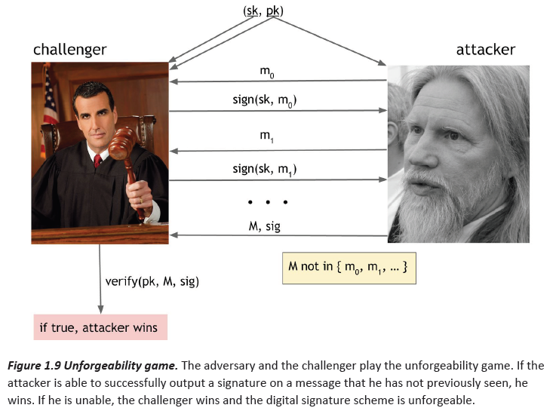
Unforgeability

Slide 35
Practical Concerns
Algorithm → Digital Signature
Science → Business Application →Science
Randomness
Ultimate requires non-deterministic (quantum)
Message size!
Sign the Hash of the msg, not msg!

Slide 36
Business Application: Signature in Bitcoin
ECDSA: Elliptic Curve Digital Signature Algorithm
US Government standard
Improvement over DSA
Bitcoin uses ECDSA over secp256k1
128 bit
To break, 2¹²⁸ cryptographic operations required

